Slide 1
AUTOMATED LEAVE MANAGEMENT SYSTEM
St. Joseph’s College,Devagiri (Autonomous)
Presented by:
Abin Sheldon Jimmington (19USCS15)
Nadha Ashraf (19USCS36)
Pranoy K. C. (19USCS30)
Guided by: Miss Anjana T.K.
Department of Computer Science

Slide 2
1. | Introduction
2. | About Our Project
3. | Module Description
4. | Data Flow Diagram
5. | Entity Relationship Diagram
6. | Table Design
7. | Input/output Form Design
Table of Contents

Slide 3
INTRODUCTION
An online leave management system is a web-based leave management application that automates every step of the employee leave management process without compromising on functionality.
Unlike on-premise leave management tools, an online leave management system gives employees the freedom to apply, approve, reject, and manage leave requests from any place, any time, and from any device.

Slide 4
ABOUT OUR PROJECT
Our proposed system is an automated leave management system that computerizes the process of applying for and approving a leave of absence and making necessary changes to the schedule accordingly.
The system stores the timetables for all the classes before hand. A faculty member applies for a leave and once leave is approved, the system automatically adjusts the timetable to accommodate the absence of that faculty member by assigning it to another member who is available at that time.

Slide 5
This avoids the hassle of manually examining the timetables and assigning substitute teachers based on availability. This system thus ensures that no class is left unmonitored during class hours.

Slide 6

MODULE DESCRIPTION

Slide 7
ADMIN
The overall working of the website is controlled by the admin. Functionalities performed by the admin are as follows:
Login
Add and manage course
Add and Manage subjects
Add and manage staff details
Allocate staff to each subject
Create and manage timetable
Approve and reject leave requests
View and Reply to complaints sent by staff

Slide 8
STAFF
Staff module can perform the following functions:
Login
View Profile
Change Password
View allocated Subjects
View timetable
Request for Leave
View Leave request status
Send Complaints
View complaint replies
Get notified on changes made in the timetable

Slide 9
PUBLIC
Public can perform the following function:
View timetable

Slide 10

DATA FLOW DIAGRAM

Slide 11
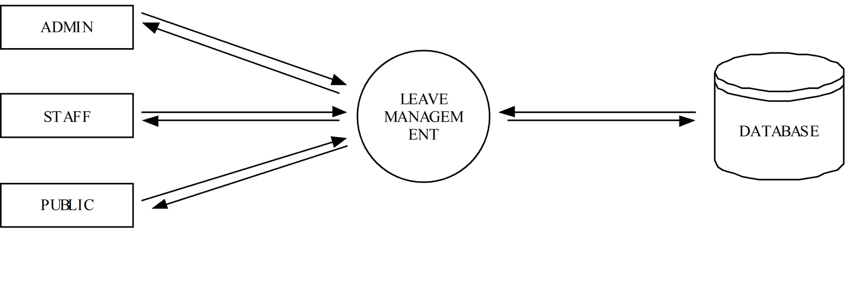
LEVEL-0

Slide 12
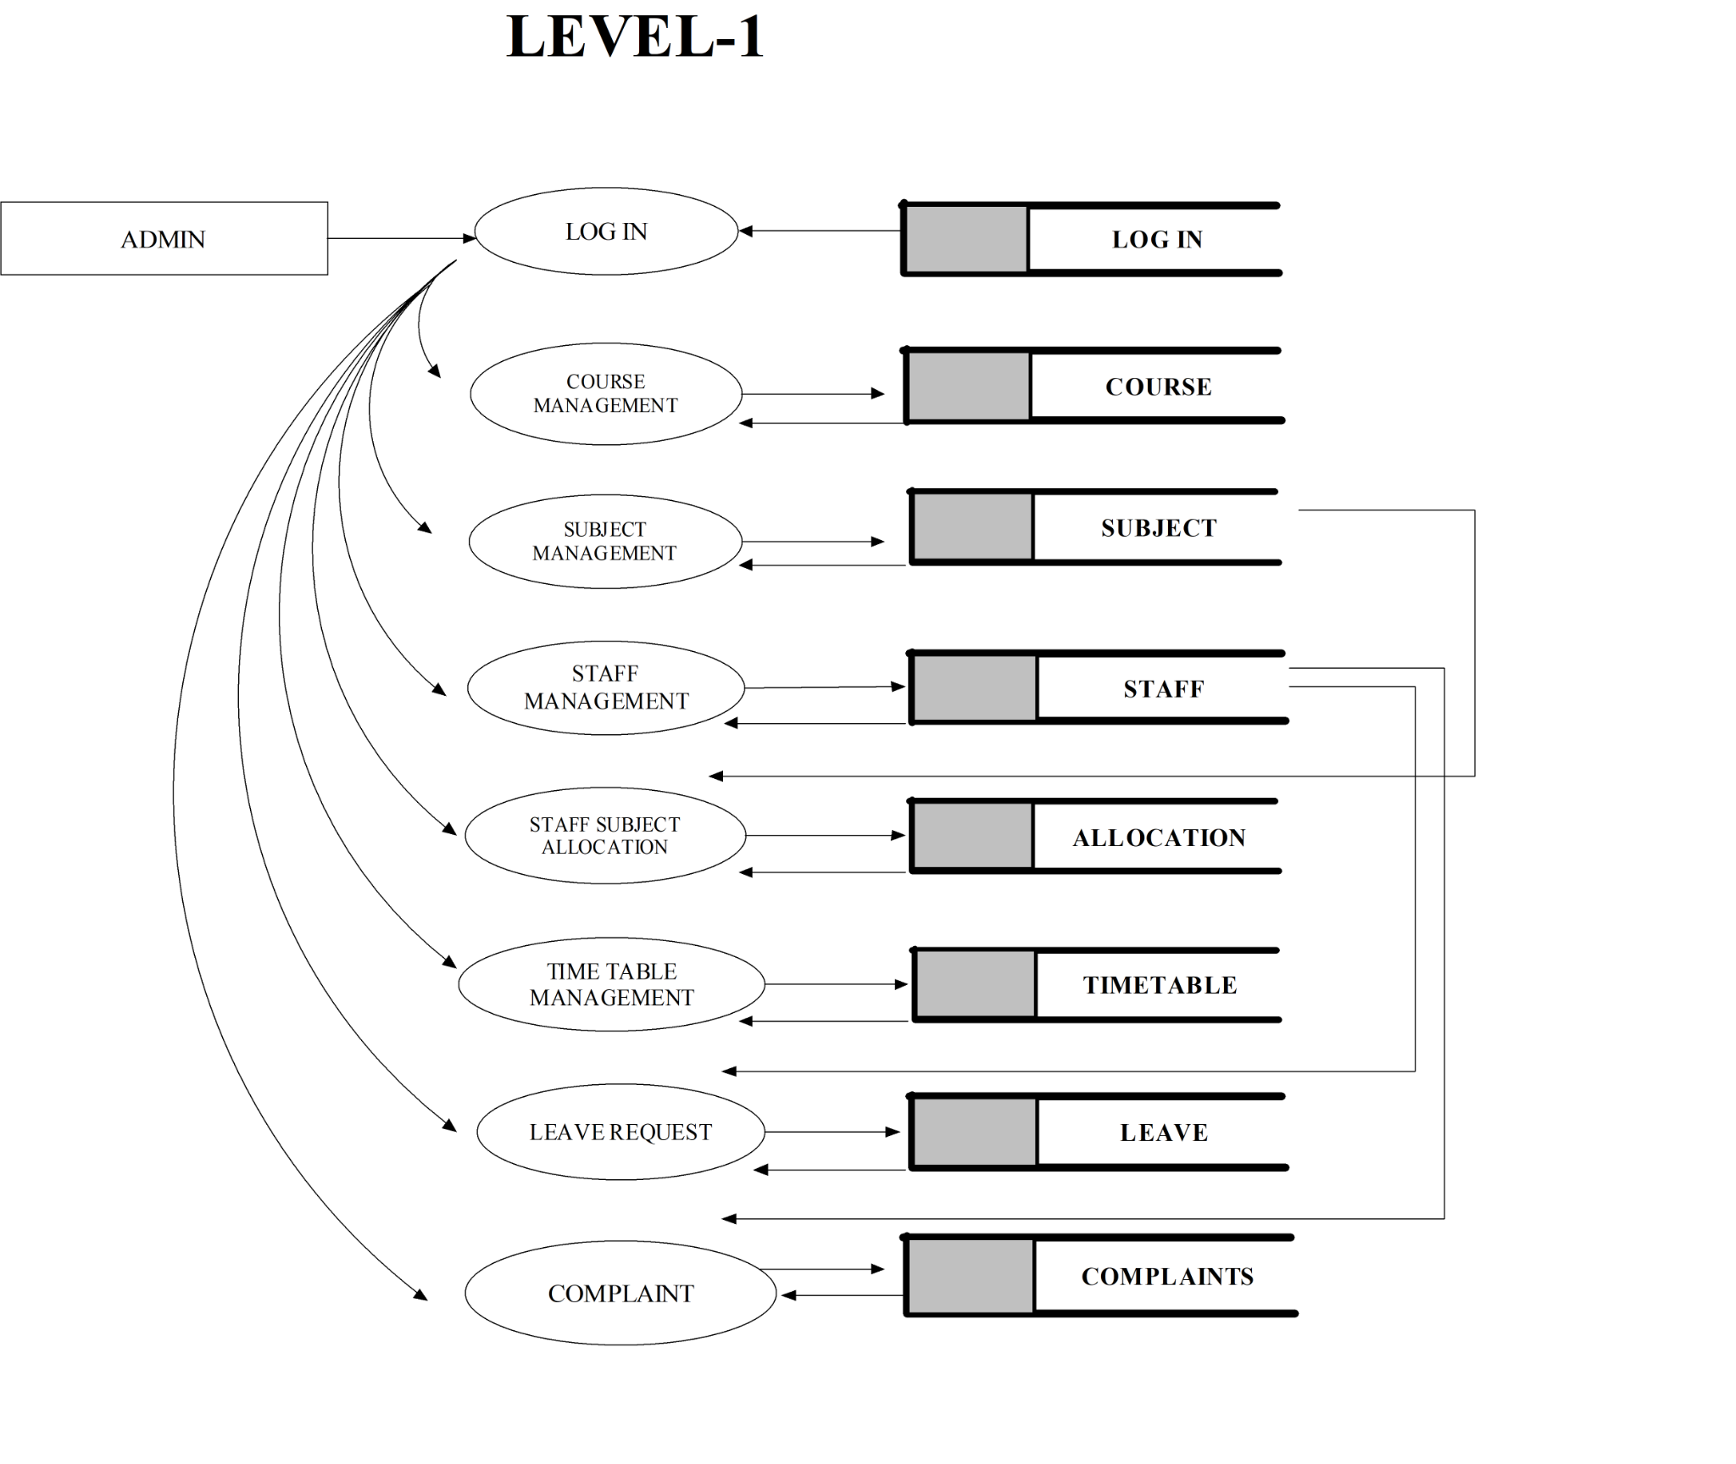

Slide 13
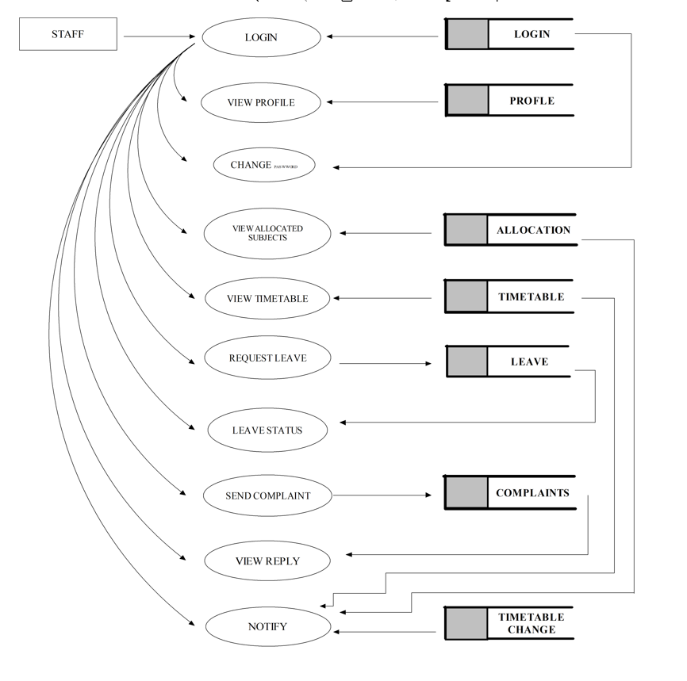
LEVEL-2

Slide 14

ENTITY-RELATIONSHIP DIAGRAM

Slide 15
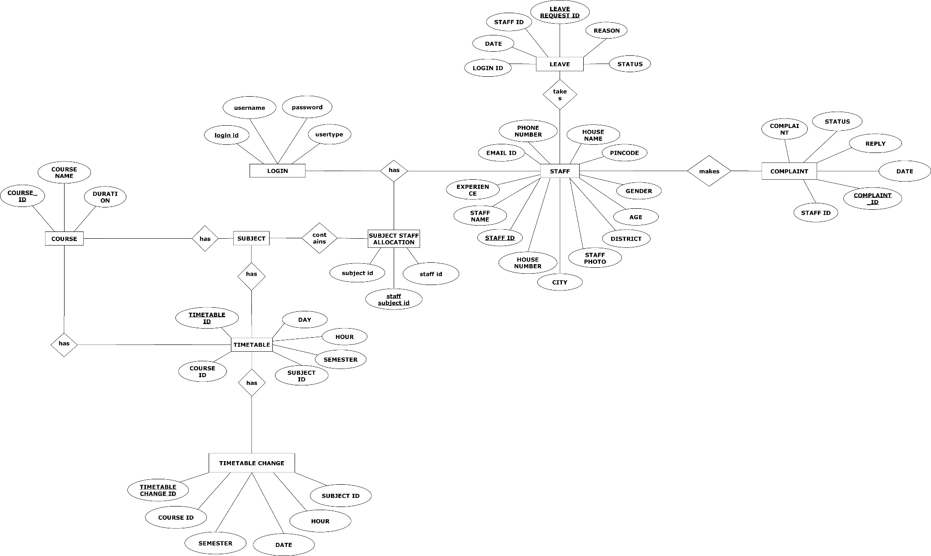

Slide 16

TABLE DESIGN

Slide 17
LOGIN TABLE
SL NO. | FIELD NAME | DATATYPE | CONSTRAINTS
1. | Login ID | varchar | Primary key
2. | Username | varchar | Not NULL
3. | Password | varchar | Not NULL
4. | Usertype | varchar | Not NULL

Slide 18
COURSE
SL NO | FIELD NAME | DATATYPE | CONSTRAINTS
1. | Course ID | varchar | Primary Key
2. | Course Name | varchar | Not NULL
3. | Duration | int | Not NULL

Slide 19
SUBJECT
SL NO | FIELD NAME | DATATYPE | CONSTRAINTS
1. | Subject ID | varchar | Primary key
2. | Subject Name | varchar | Not NULL
3. | Course ID | varchar | Foreign Key
4. | Semester | varchar | Not NULL

Slide 20
STAFF
SL NO | FIELD NAME | DATATYPE | CONSTRAINTS
1. | Staff ID | varchar | Primary Key
2. | Staff Name | varchar | Not NULL
3. | Experience | int | Not NULL
4. | Staff Photo | file | Not NULL
5. | Age | int | Not NULL
6. | Gender | varchar | Not NULL

Slide 21
7. | Mail ID | varchar | Not NULL
8. | Phone Number | int | Not NULL
9. | Login ID | varchar | Foreign Key
10. | House Name | Varchar | Not NULL
11. | House Number | Varchar | Not NULL
12. | City | Varchar | Not NULL
13. | Pincode | int | Not NULL

Slide 22
SUBJECT STAFF ALLOCATION
SL NO | FIELD NAME | DATATYPE | CONSTRAINTS
1. | Staff Subject ID | varchar | Primary key
2. | Subject ID | varchar | Foreign key
3. | Subject Name | varchar | Foreign key

Slide 23
TIMETABLE
SL NO | FIELD NAME | DATATYPE | CONSTRAINTS
1. | Timetable ID | varchar | Primary key
2. | Day | Varchar | Not NULL
3. | Hour | Varchar | Not NULL
4. | Course ID | Varchar | Foreign Key
5. | Semester | varchar | Not NULL
6. | Subject ID | varchar | Foreign Key

Slide 24
LEAVE
SL NO | FIELD NAME | DATATYPE | CONSTRAINTS
1. | Leave Request ID | varchar | Primary Key
2. | Staff ID | varchar | Foreign Key
3. | Date | date | Not NULL
4. | Reason | varchar | Not NULL
5. | Status | varchar | Not NULL

Slide 25
COMPLAINT
SL NO | FIELD NAME | DATATYPE | CONSTRAINTS
1. | Complaint ID | varchar | Primary Key
2. | Staff ID | varchar | Foreign Key
3. | Date | date | Not NULL
4. | Complaint | Varchar | Not NULL
5. | Reply | Varchar | Not NULL
6. | Status | varchar | Not NULL

Slide 26

INPUT/OUTPUT FORM DESIGN

Slide 27
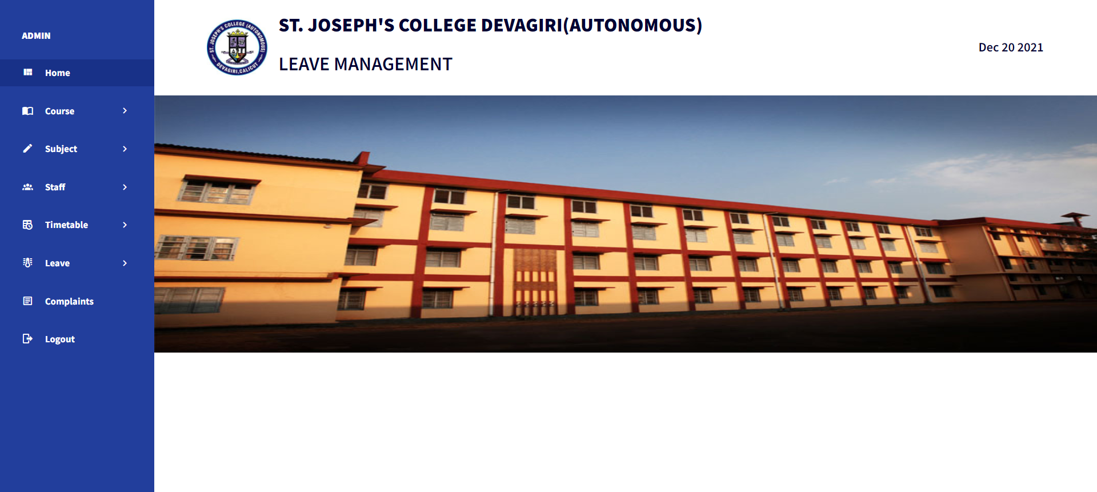
ADMIN HOME PAGE

Slide 28
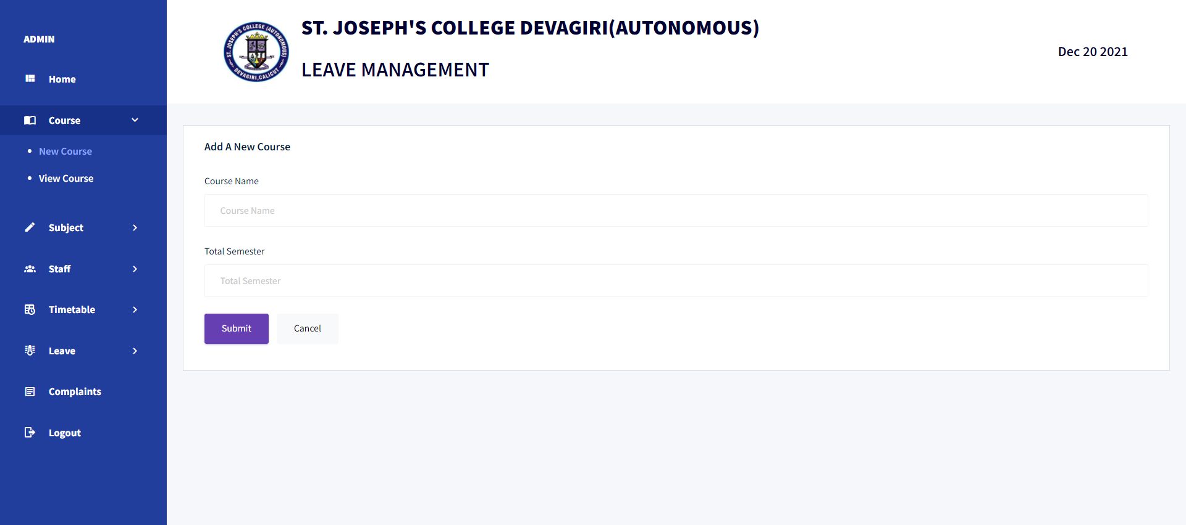
ADD COURSE PAGE

Slide 29
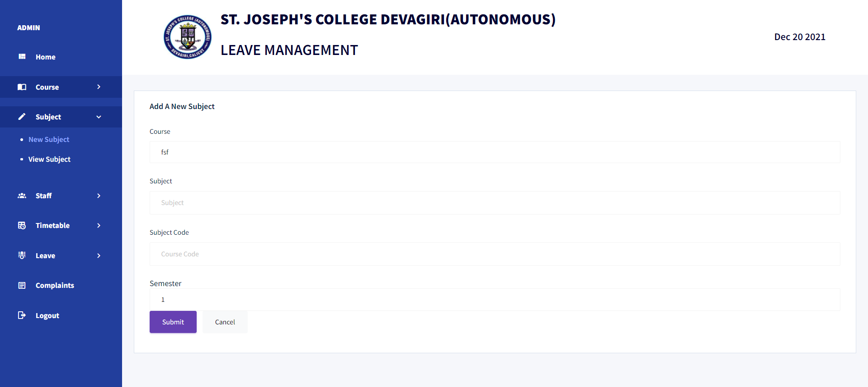
ADD NEW SUBJECT PAGE

Slide 30
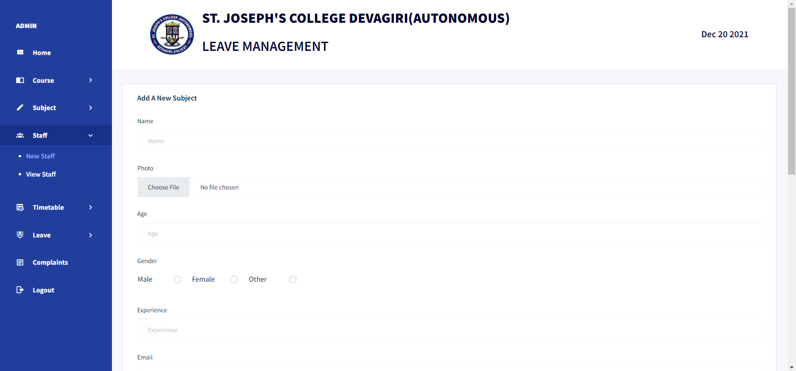
ADD NEW STAFF

Slide 31
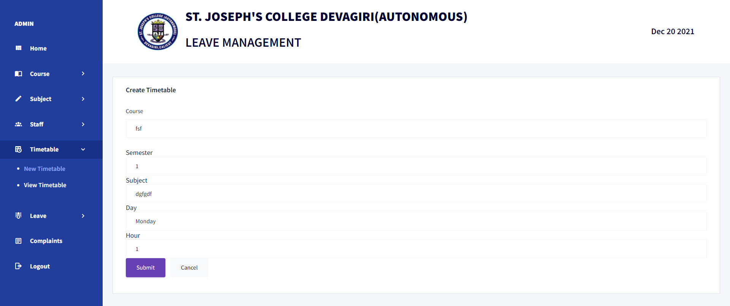
CREATE TIMETABLE

Slide 32
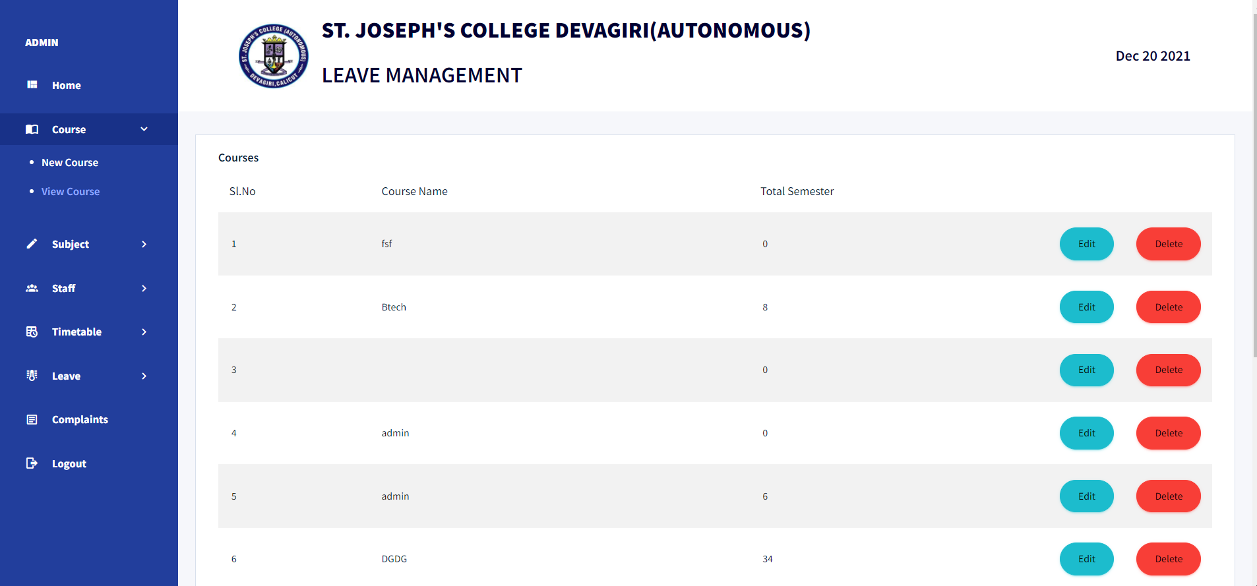
OUTPUT-VIEW COURSES

Slide 33
THANK YOU

